Slide 2
Heat transfer occurs through conduction, convection and radiation
Sound waves are longitudinal
Sound travels fastest through solids

Slide 3
We will explain the properties of light and how it travels
TRACK WITH ME
READ WITH ME
SWBAT Outline the nature of light SWBAT Explain the law of reflection SWBAT Summarise the process of refraction

Slide 4
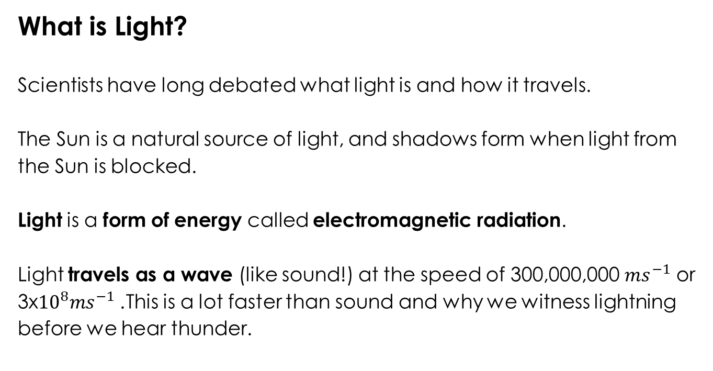
SWBAT Outline the nature of light
What is Light?
Scientists have long debated what light is and how it travels.
The Sun is a natural source of light, and shadows form when light from the Sun is blocked.
Light is a form of energy called electromagnetic radiation. Light travels as a wave (like sound!) at the speed of 300,000,000 ${ms}^{−1}$ or 3x${10}^{8}{ms}^{−1}$. This is a lot faster than sound and why we witness lightning before we hear thunder.

Slide 5
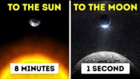

Slide 6
Notes:
CFU higher frequency/lower frequency
+ wavelength

Slide 7
colour
Discuss: Does ‘white light’ exist?

Slide 8
Colour
Type here
Type here
Type here
Type here

Slide 9
SWBAT Outline the nature of light
Transparent materials allow light to travel straight through.
(eg. Glass, water, air)
Translucent materials allow some light through so we cannot form a clear image
(eg. Wax paper, frosted glass)
Opaque objects do not let light through at all
(eg. Wood, metal, cardboard)

Slide 10
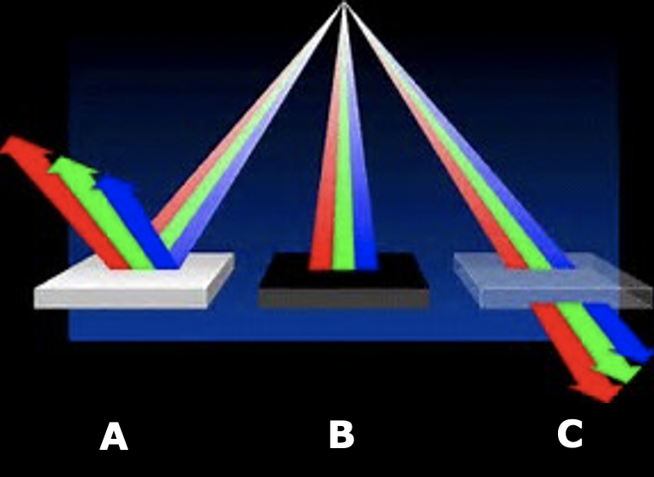
SWBAT Outline the nature of light
Which diagram shows transparent, translucent, opaque?

Slide 11
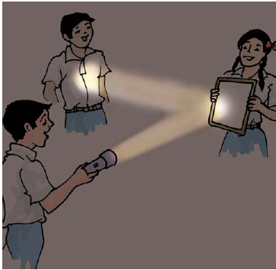
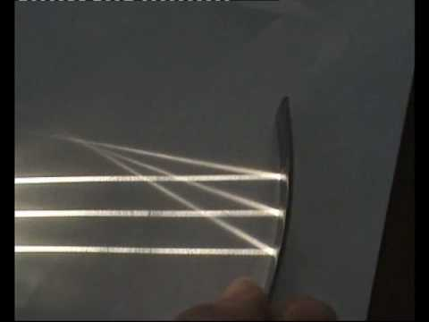

What do property of light do each of these images show?

Slide 12
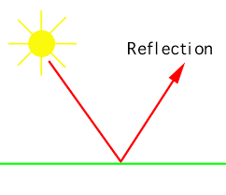
SWBAT Explain the law of reflection
TEACHER CUE
CFU
Reflection
Light when hitting a smooth surface, is reflected back and is known as the law of reflection.

Slide 13
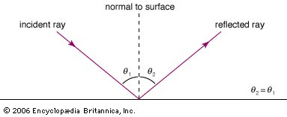
VOCABULARY
Incident Ray: a ray that hits a surface Reflected Ray: a ray that is reflected from a surface
SWBAT Explain the law of reflection
The law of reflection
The law of reflection states that
the angle of the reflected ray is equal to the angle of the incident ray

Slide 14
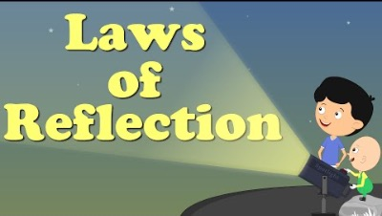

Slide 15
SWBAT Explain the law of reflection
In your books..
Explain the law of reflection
(include the words reflected, angle and incident ray)

Slide 16
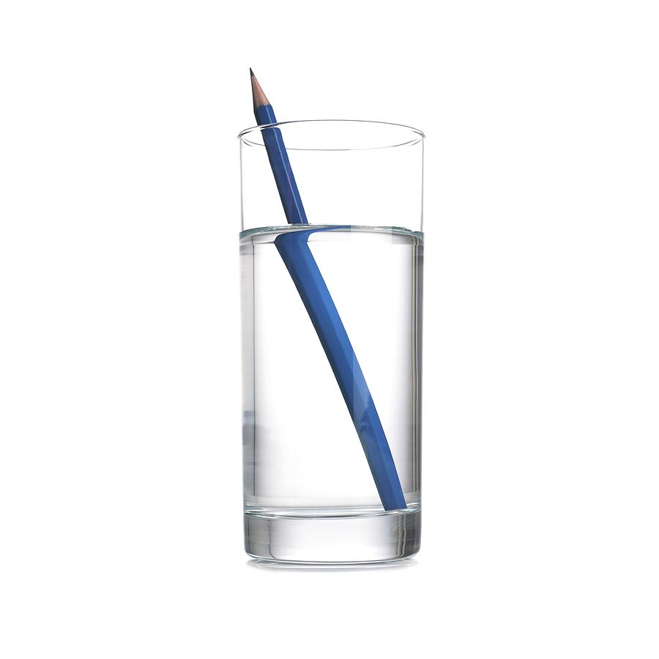
SWBAT Summarise the process of refraction

Slide 17
SWBAT Summarise the process of refraction
HINT
Transparent means to be able to see through
However when light moves from one transparent medium to another transparent medium (ie. Air to glass) some of the light is reflected and some is transmitted to the second medium.
As it moves to the second medium it changes its direction of travel

Slide 18
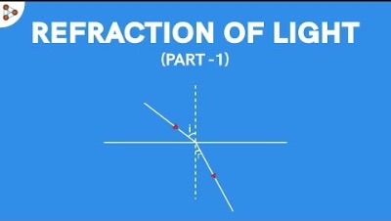

Slide 19
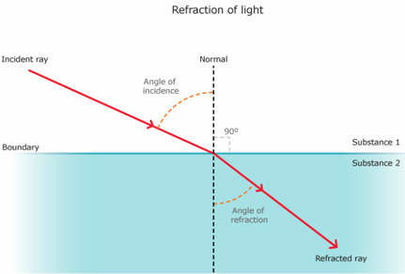
SWBAT Summarise the process of refraction
TEACHER CUE
Can you think a medium that is more dense than air. Remember: dense is the closeness of particles (solid, liquid, gas)
Refraction
Is the change in direction of light and is due to the speed of light in one medium to another.
Light waves slow down when it
hits a more dense medium

Slide 20
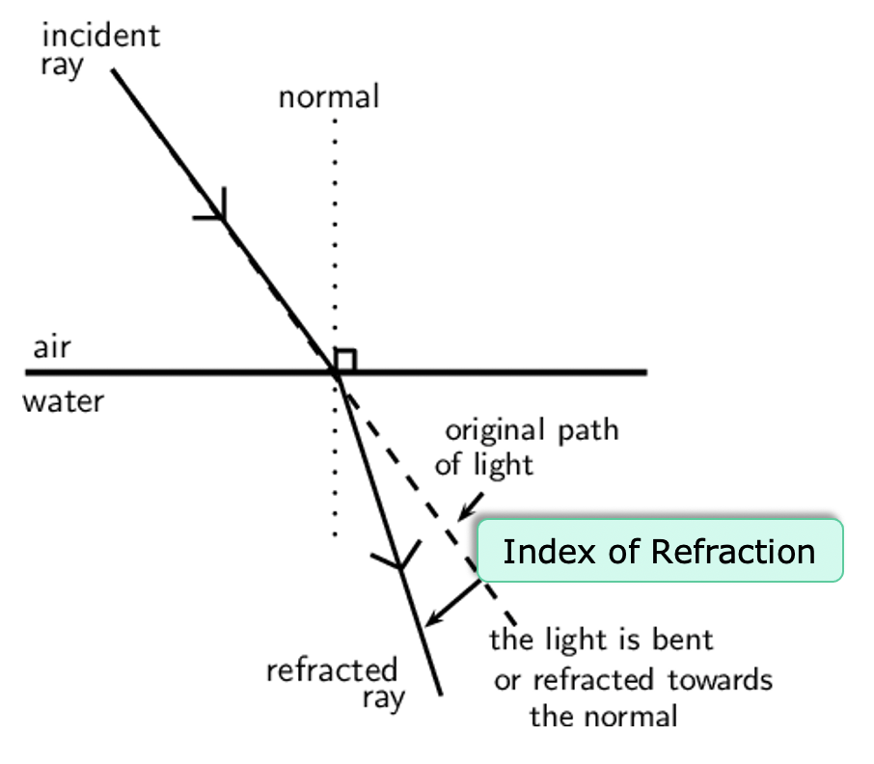
SWBAT Summarise the process of refraction
Index of refraction
A measure of how much a ray of light bends when it enters that material.

Slide 21
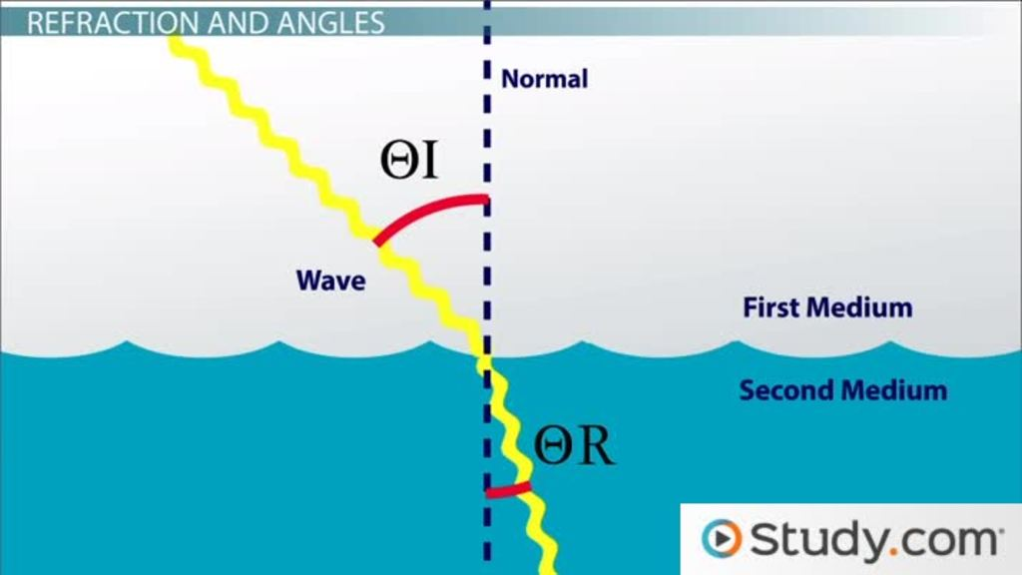
SWBAT Summarise the process of refraction
Mediums
A medium is the substance that carries a wave from one location to another
EXAMPLES:
Air
Water
Vacuum
Glass

Slide 22
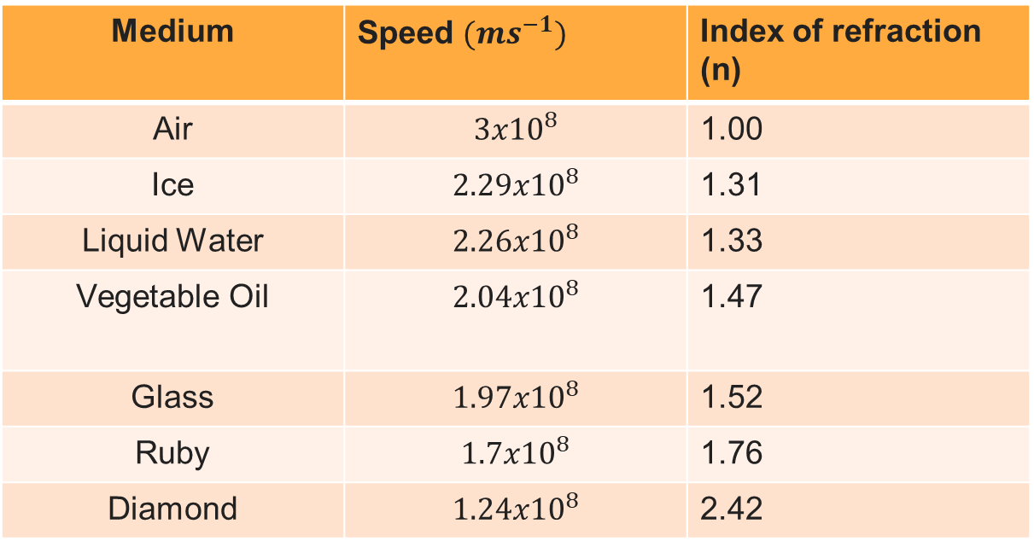
SWBAT Summarise the process of refraction
The Speed of light in different mediums
Medium | Speed ${(ms}^{−1})$ | Index of refraction (n)
Air | $${3x10}^{8}$$ | 1.00
Ice | $${2.29x10}^{8}$$ | 1.31
Liquid Water | $${2.26x10}^{8}$$ | 1.33
Vegetable Oil | $${2.04x10}^{8}$$ | 1.47
Glass | $${1.97x10}^{8}$$ | 1.52
Ruby | $${1.7x10}^{8}$$ | 1.76
Diamond | $${1.24x10}^{8}$$ | 2.42

Slide 23
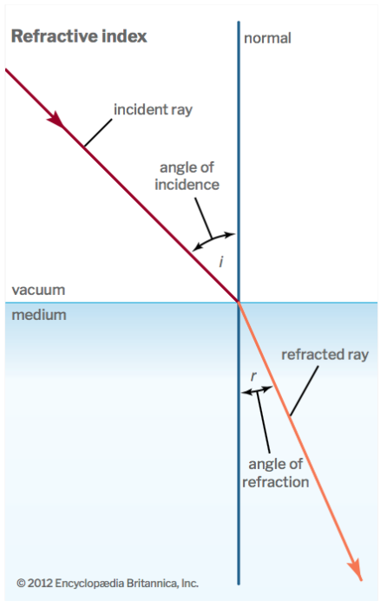
SWBAT Summarise the process of refraction
Refraction
The angle of refraction, is never equal to the angle of incidence.

Slide 24
SWBAT Summarise the process of refraction
Reflection or Refraction?
Angle of reflection = angle of incidence
______________________
Angle of reflection is not equal to angle of incidence
_______________________

Slide 25
EXIT TICKET:
STAMP TO THE FINISH LINE
You will need your book stamped after this task!

Slide 26
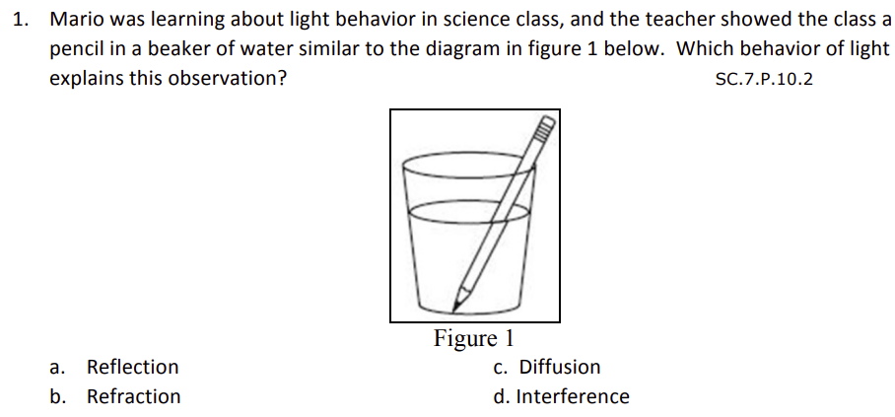
STAMP TO THE FINISH LINE

Slide 27
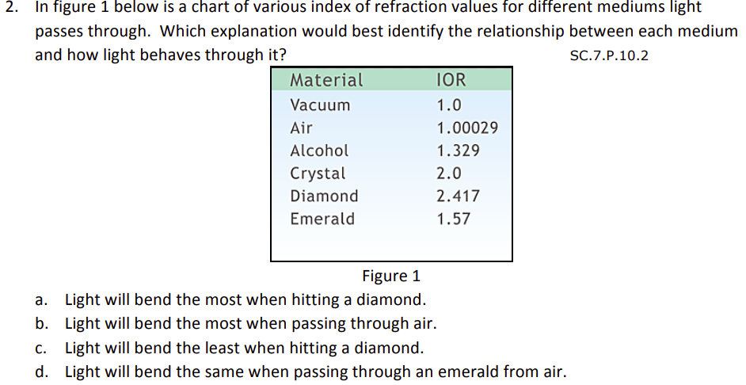
STAMP TO THE FINISH LINE

Slide 28
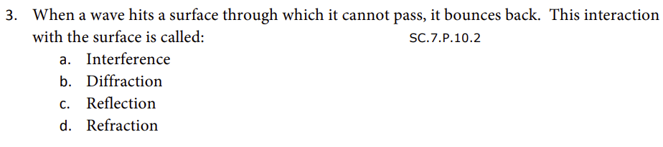
STAMP TO THE FINISH LINE

Slide 29
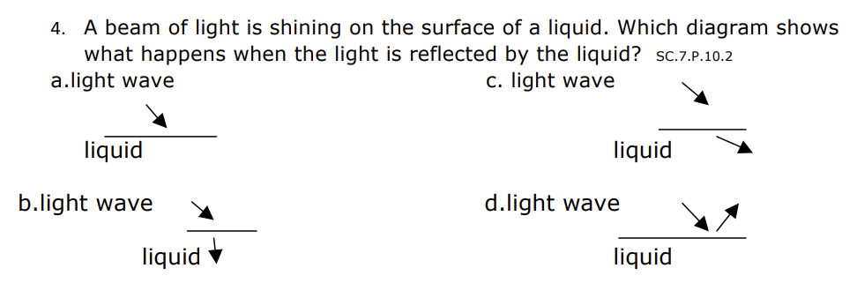
STAMP TO THE FINISH LINE

Slide 30
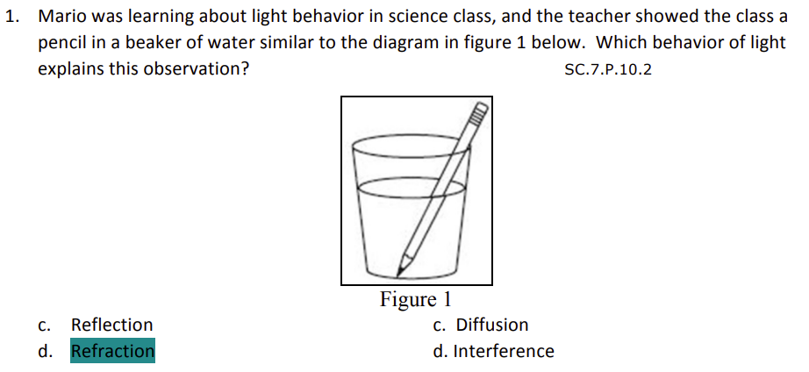

Slide 31
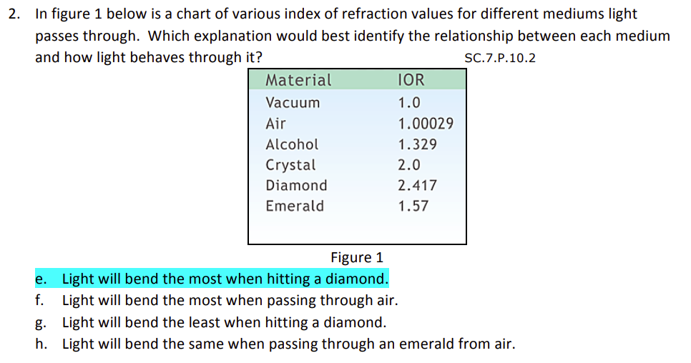

Slide 32
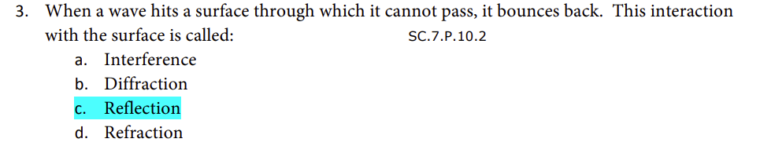

Slide 33
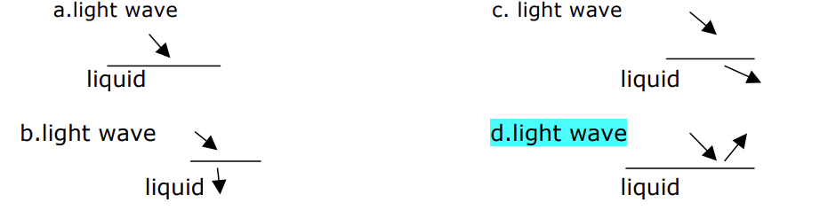

Slide 34
We will explain the properties of light and how it travels
TRACK WITH ME
READ WITH ME
SWBAT Outline the nature of light SWBAT Explain the law of reflection SWBAT Summarise the process of refraction

